Slide 1
About me!

Slide 2
First complete these sentences in your exercise book:
My name is…………………...
I’m from……………………….
I live in…………………………
I like……………………………..
I don’t like…………………..
I’ve got…………………………

Slide 3
Let’s read about two famous people and play a memory game!

Slide 4
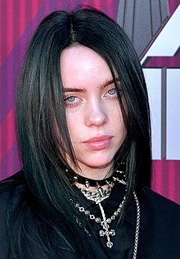
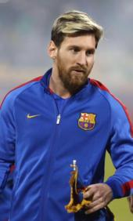
Hi everyone! I am Lionel Messi! I am 32 years old. I come from Argentina but I live in Barcelona, in Spain. I am a football player. I love football. I like dogs, too. I’ve got a big brown dog.
Hi everyone! I am Billie Eilish!
I am 18 years old. I am a singer. I come from the USA. I live in Los Angeles with my family. I like fruit and vegetables. I like animals, too. I’ve got a dog and a cat. What about you?

Slide 5

Let’s check your memory!
Do you remember who says what?
Good Luck!!!
Click below and do the quiz.
http://www.quia.com/quiz/7652524.html

Slide 6
LET’S PLAY!
Click below to play a matching game. Match the questions with the answers.
http://www.quia.com/jg/3110318.html
Have fun!!!

Slide 7

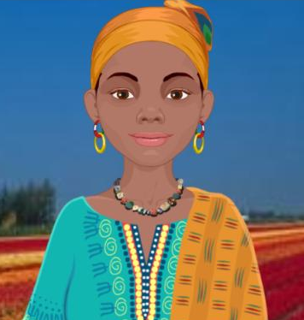
Listen and complete the following in your exercise book :
Hi! I’m Amara. I’m ……..years old. I’m from……….. I ………. in Kenya with my family. I like fruit. I ……………. mangoes and pineapples. I ………....… bananas. I like animals too. I’ve got a ………… It’s blue, ………….., yellow and …………..

Slide 8
Now, write a paragraph about you.
(Write it in your exercise book).
Put your picture here
Hi! I’m ………………… I’m ……..years old. ………………………………………………………………………………………………………………………………………………………………………………………………………………………………………………………………………………………………………………………………………………………………………………………………………………………….

Slide 9
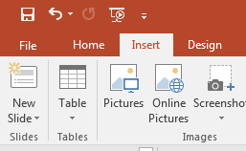
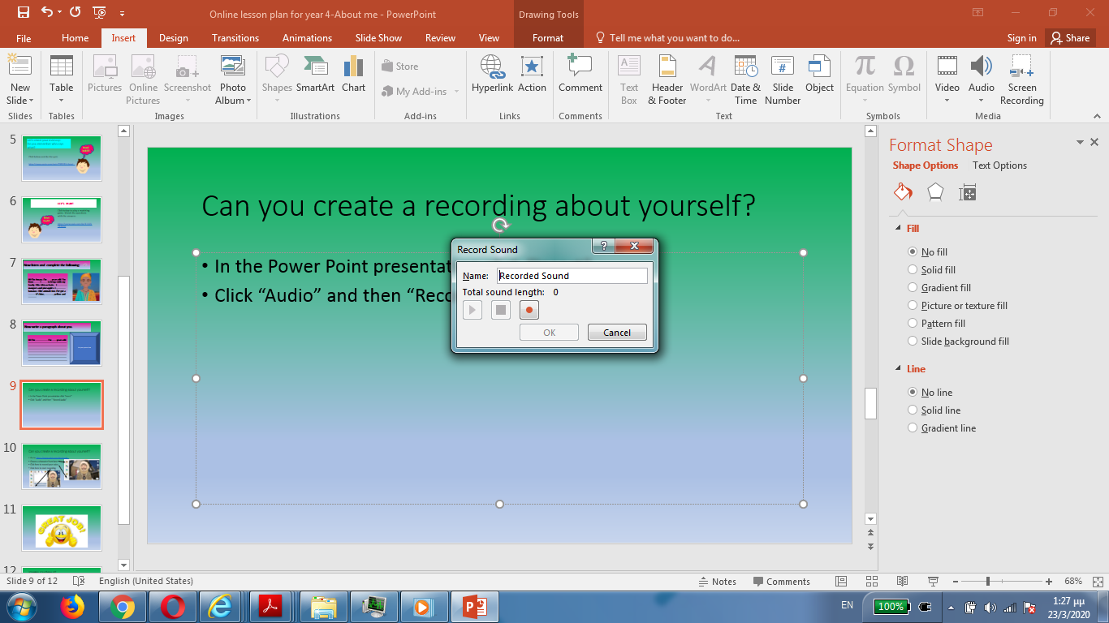
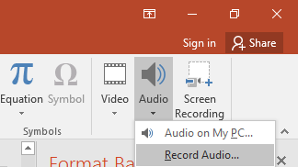
Can you record your paragraph?
Ask your parents to help you. You can open a Power Point Presentation and do the following:
1. In the Power Point presentation click “Insert”
2. Click “Audio” and then “Record Audio”
3. You will see this
4. Write your name and press
5. Start speaking.

Slide 10
Another idea!
You can record yourself using your parents’ mobile phone!
Then your parents can help you to send your recording to your teacher!

Slide 11


Slide 12
Images courtesy of:
https://en.wikipedia.org/wiki/Lionel_Messi
https://en.wikipedia.org/wiki/Billie_Eilish
Presentation designed by the English Curriculum Development team, Cyprus Ministry of Education and Culture

