Slide 1
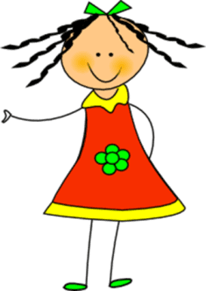



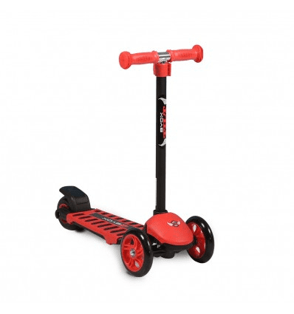
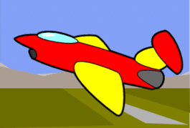
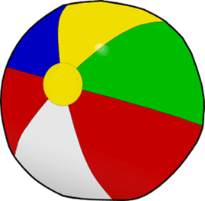
Many, many toys!

Slide 2






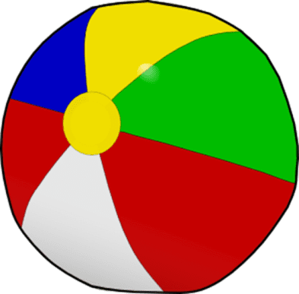
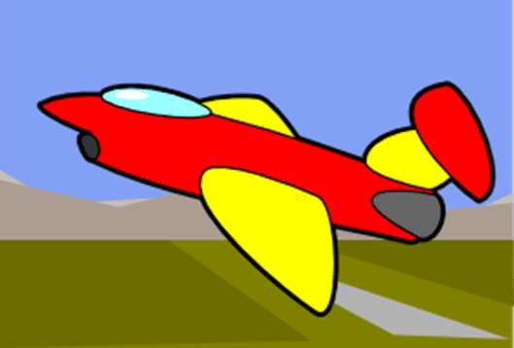
Listen, point and say

Slide 3

Let’s play a guessing game!

Slide 4



Slide 5


Slide 6



Slide 7


Slide 8


Make a question
Is it a …….. ?

Slide 9


Slide 10


Make a question
Is it a …….. ?

Slide 11


Slide 12

Let’s play!
Click on the link below:
http://www.quia.com/jg/3114018.html

Slide 13
Listen to the chant!
This is my doll.
This is my doll.
It’s big and tall!
This is my car.
This is my car.
It’s red and black!

Slide 14

Let’s say the chant
together!

Slide 15
Let’s say the chant!
This is my doll.
This is my doll.
It’s big and tall!
This is my car.
This is my car.
It’s red and black!

Slide 16

Let’s sing 10 little aeroplanes!
Click here:
https://youtu.be/4J5ywWdp_-M

Slide 17
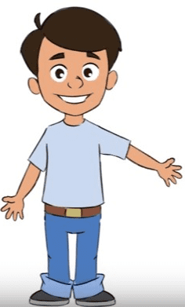

This is my poster. Listen!
Now, make your own poster!

Slide 18
Images courtesy of:
http://www.clker.com
clipart-library.com
Presentation designed by the English Curriculum Development team,
Cyprus Ministry of Education, Culture, Sports and Youth.

